Slide 1


Slide 2
Environment setup
Notes:
HELLO EVERBODY.
TODAY WE ARE GOING SETUP OUR DEVELOPMENT ENVIRONMENT INCLUDING JDK AND INTEGRATED DEVELOPMENT ENVIRONMENT IN WHICH WE ARE GOING TO DEVELOP OUR PROOF OF CONCEPT PROJECT.

Slide 3

Java Development Tool Kit
Notes:
FISRT OF ALL WE WILL START TO SETUP OUR ENVIRONMENT WITH JAVA DEVELOPMEN KIT WHICH IS JDK8.
LETS LEARN WHAT IS JDK AND WHAT IT IS FOR BASICCALY.
THE JAVA DEVELOPMENT KIT (JDK) IS A SOFTWARE DEVELOPMENT ENVIRONMENT USED FOR DEVELOPING JAVA APPLICATIONS AND APPLETS. IT INCLUDES THE JAVA RUNTIME ENVIRONMENT (JRE), AN INTERPRETER/LOADER (JAVA), A COMPILER (JAVAC), AN ARCHIVER (JAR), A DOCUMENTATION GENERATOR (JAVADOC) AND OTHER TOOLS NEEDED IN JAVA DEVELOPMENT.
PEOPLE NEW TO JAVA MAY BE CONFUSED ABOUT WHETHER TO USE THE JRE OR THE JDK. TO RUN JAVA APPLICATIONS AND APPLETS, SIMPLY DOWNLOAD THE JRE. HOWEVER, TO DEVELOP JAVA APPLICATIONS AND APPLETS AS WELL AS RUN THEM, THE JDK IS NEEDED.
JAVA DEVELOPERS ARE INITIALLY PRESENTED WITH TWO JDK TOOLS, JAVA AND JAVAC. BOTH ARE RUN FROM THE COMMAND PROMPT. JAVA SOURCE FILES ARE SIMPLE TEXT FILES SAVED WITH AN EXTENSION OF. JAVA. AFTER WRITING AND SAVING JAVA SOURCE CODE, THE JAVAC COMPILER IS INVOKED TO CREATE. CLASS FILES. ONCE THE. CLASS FILES ARE CREATED, THE 'JAVA' COMMAND CAN BE USED TO RUN THE JAVA PROGRAM.
THERE ARE DIFFERENT JDKS FOR VARIOUS PLATFORMS. THE SUPPORTED PLATFORMS INCLUDE WINDOWS, LINUX AND SOLARIS. MAC USERS NEED A DIFFERENT SOFTWARE DEVELOPMENT KIT, WHICH INCLUDES ADAPTATIONS OF SOME TOOLS FOUND IN THE JDK.

Slide 4
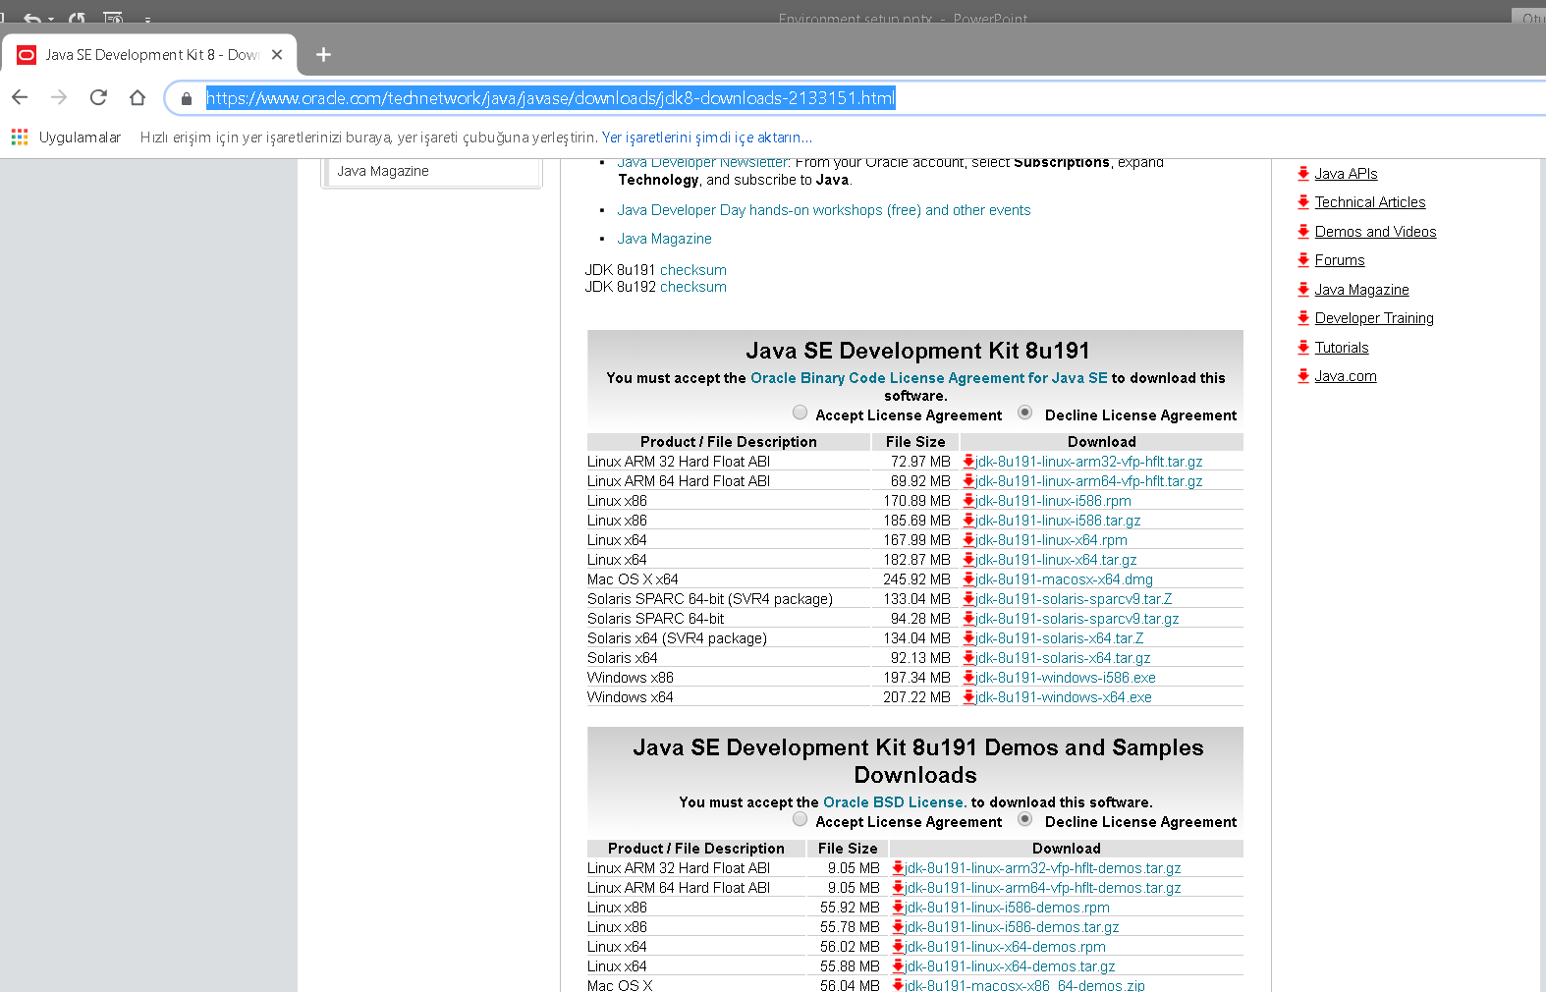
Java Development Tool Kit
https://www.oracle.com/technetwork/java/javase/downloads/jdk8-downloads-2133151.html
Notes:
{click} TO GET THE JDK8, GO TO THE ORACLE WEB SITE SHOWN AND DOWNLOAD THE JDK VERSION WHICH IS PROPER TO YOUR OPERATIN SYSTEM AND SETUP IT EASILY.

Slide 5
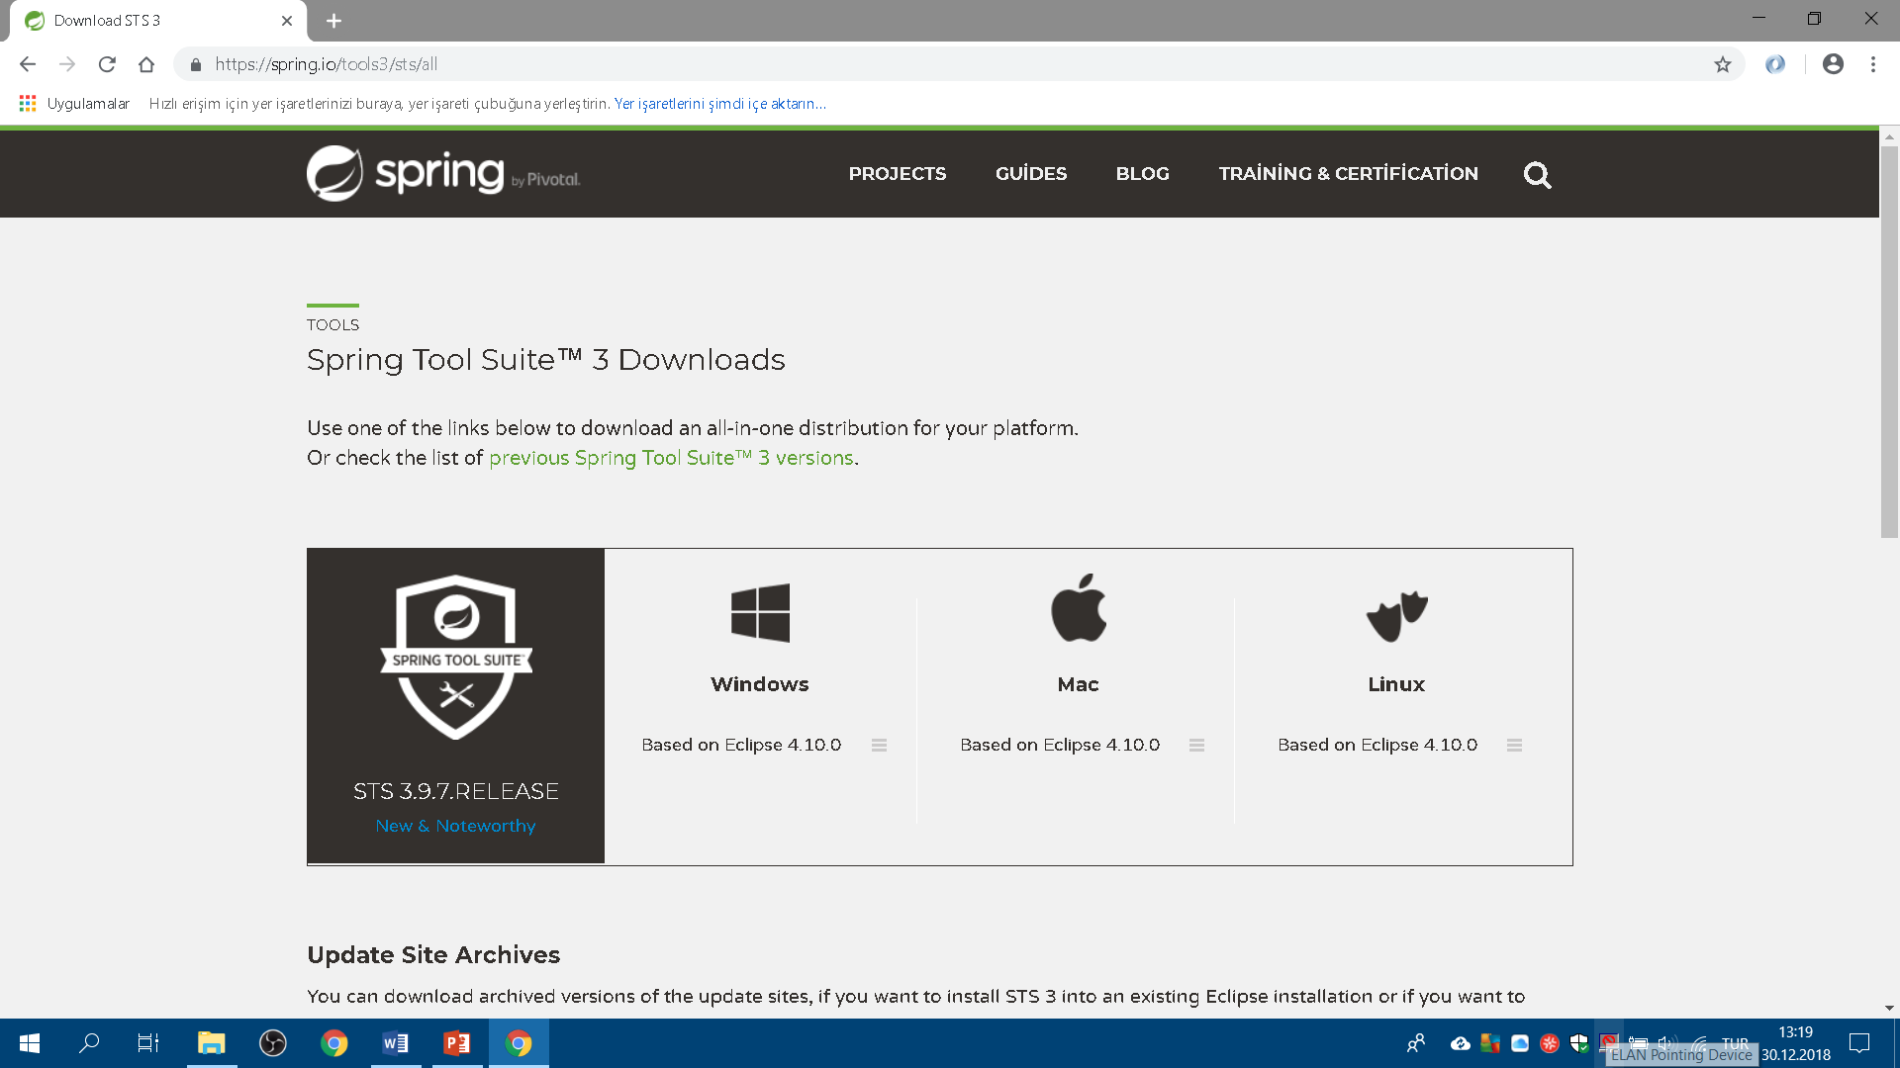
About IDE
https://spring.io/tools3/sts/all
Notes:
{click} AFTER SETTING UP JDK8, WE NEED TO INSTALL OUR IDE. BEFORE THAT LETS LEARN SOME INFO ABOUT ECLIPSE AND STS.
{click} SPRING TOOL SUITE (STS) IS A SET OF TOOLS FOR CREATING SPRING APPLICATIONS. IT CAN BE EITHER INSTALLED AS A PLUGIN TO AN EXISTING INSTALLATION OF ECLIPSE JEE OR CAN BE INSTALLED STANDALONE. THE STANDALONE VERSION OF STS IS ALSO PACKAGED WITH ECLIPSE EE, SO ALL ECLIPSE FEATURES FOR JAVA EE DEVELOPMENT ARE AVAILABLE IN STS TOO.
FROM PIVOTAL SPRING WEB SITE SHOWN DONWLOAD THE 3.9.2 SPRING SOURCE TOOL SUITE WHICH IS PROPER TO OUR OPERATING SYSTEM. IN BOTH SETUP OPERATIONS, PLEASE BE CAREFULL THAT PATHS DO NOT INCLUDES SPACES OR SOME OTHER SPECIAL CHARACTERS LIKE NON-ENGLISH LETTERS. WHILE SETTING UP STS TRY TO SETUP IN HIGHEST PATH. FOR EXAMPLE FOR WINDOWS “C:\DEMO”.

Slide 6
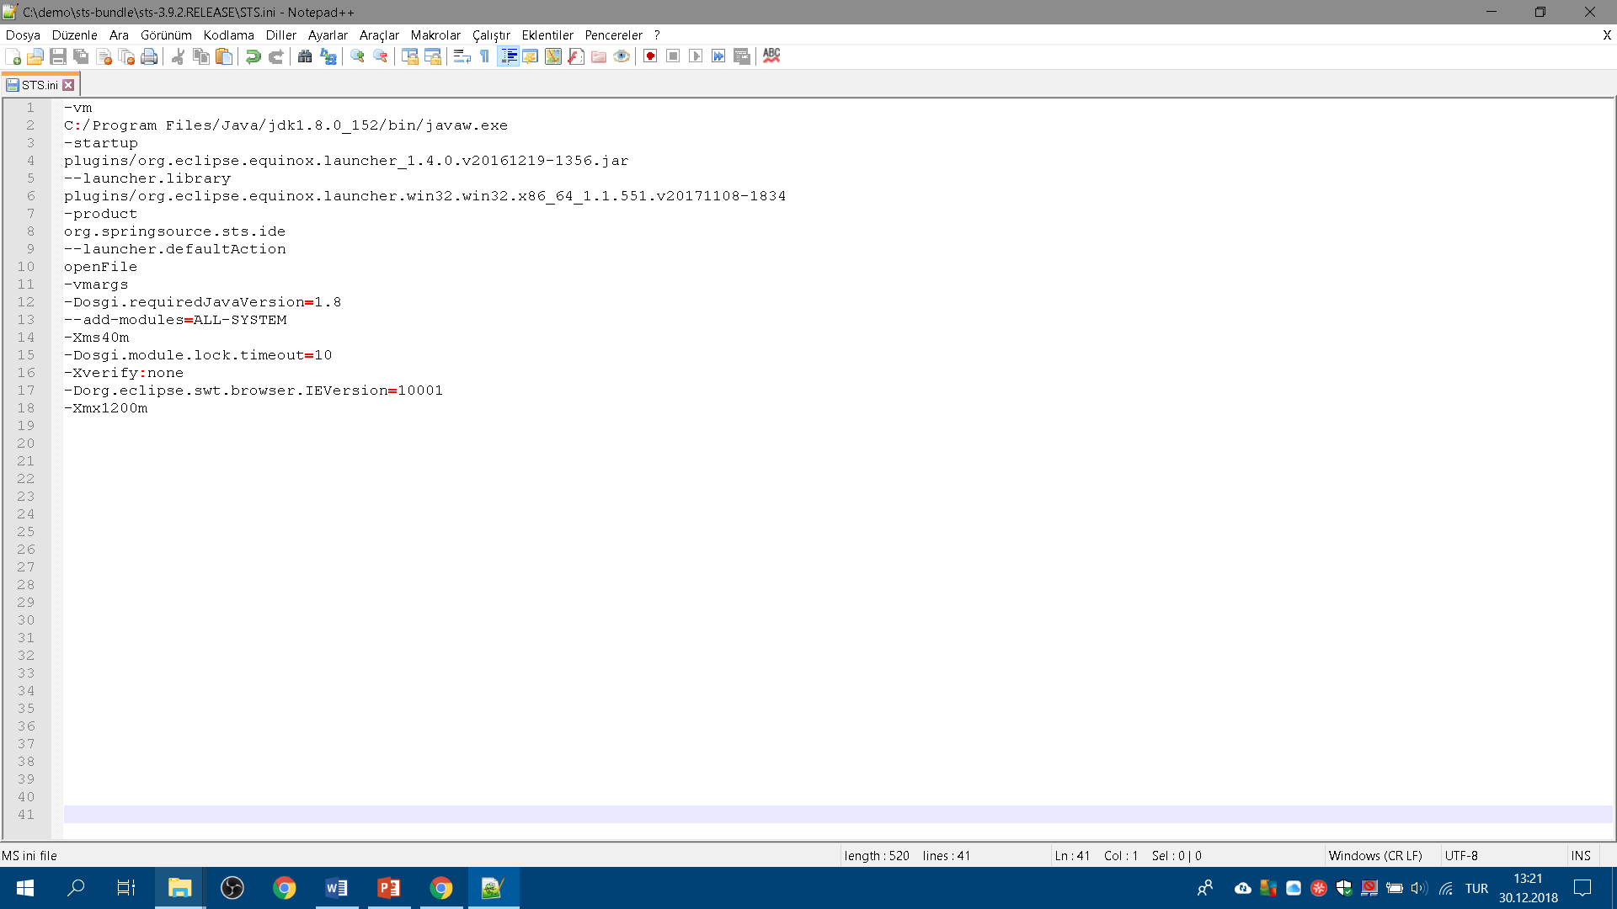
About STS.ini file
Notes:
AFTER COMPLETING JDK8 AND STS 3.9.2 INSTALLATION, FIND THE STS.INI FILE INSIGHT THE STS DIRECTORY WHICH IS THE CONFIGURATION FILE USED TO CONTROL THE ECLIPSE OR STS STARTUP. WE CAN CONFIGURE ECLIPSE VM ARGUMENTS SUCH AS JDK TO BE USED, PERMGEN SPACE, MAXIMUM AND MINIMUM HEAP SIZE USING XMS, XMX PARAMETERS. IN STS.INI FILE, IN FIRST LINE ADD THE JDK8 INSTALLATION ABSOLUTE PATH AFTER “-VM” KEYWORD. IN THIS WAY STS WILL WORK WITH THIS SPECIFIED JDK VERSION WHICH WE JUST SET UP. ADDING THIS ABSOLUTE PATH TO THE STS.INI FILE, WE WILL PREVENT FROM THE JDK VERSION PROBLEMS IN THE ENVIRONMENT IN WHICH MORE THAN ONE JDK INSTATTALTIONS EXIST. IN THIS WAY OUR IDE WILL START UP WITH THIS SPECIFIC JDK VERSION OR THIS LINE WILL PREVENT FROM MISSING JDK.

Slide 7

End of this course
Notes:
IN THIS CLASS, WE TALKED ABOUT INSTALLING JAVA DEVELOPMENT KID AND INTEGRATED DEVELOPMENT ENVIRONMENT WHICH IS SPRING SOURCE TOOL SUITE. AND ALSO WE LEARNED SOME IMPORTANT POINTS THAT ARE NEEDED TO BE TAKEN CARE OF.
SEE YOU NEXT CLASS.
HAVE A NICE DAY.

